Slide 1
AWS Reference Material
Elastic File System
Amazon Elastic File System (Amazon EFS) provides simple, scalable file storage for use.with Amazon EC2. With Amazon EFS, storage capacity is elastic, growing and shrinking automatically as you add and remove files, so your applications have the storage they need, when they need it. Amazon EFS has a simple web services interface that allows you to create and configure file systems quickly and easily. The service manages all the file storage infrastructure for you, meaning that you can avoid the complexity of deploying, patching, and maintaining complex file system configurations
Amazon EFS is designed to provide the throughput, IOPS, and low latency needed for a broad range of workloads.
Amazon EFS provides file storage in the AWS Cloud. With Amazon EFS, you can create a file
system, mount the file system on an Amazon EC2 instance, and then read and write data to
and from your file system. You can mount an Amazon EFS file system in your VPC, through
the Network File System versions 4.0 and 4.1 (NFSv4) protocol.
You can access your Amazon EFS file system concurrently from Amazon EC2 instances in your
Amazon VPC, so applications that scale beyond a single connection can access a file system.
Amazon EC2 instances running in multiple Availability Zones within the same region can
access the file system, so that many users can access and share a common data source.
To access your Amazon EFS file system in a VPC, you create one or more mount targets in the VPC. A mount target provides an IP address for an NFSv4 endpoint at which you can mount an Amazon EFS file system. You mount your file system using its Domain Name Service (DNS) name, which resolves to the IP address of the EFS mount target in the same Availability Zone as your EC2 instance. You can create one mount target in each Availability Zone in an AWS Region. If there are multiple subnets in an Availability Zone in your VPC, you create a mount target in one of the subnets. Then all EC2 instances in that Availability Zone share that mount target.
Mount targets themselves are designed to be highly available. As you design for high availability and failovers to other Availability Zones (AZs), keep in mind that the IP addresses and DNS for your mount targets in each AZ are static.
After mounting the file system by using the mount target, you use it like any other POSIX- compliant file system. For information about NFS-level permissions and related

Slide 2
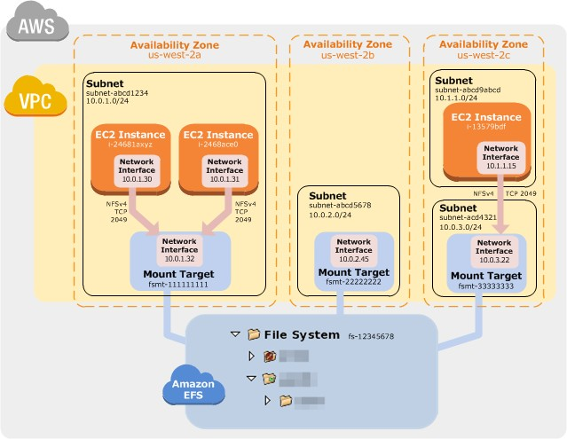
considerations, see Working with Users, Groups, and Permissions at the Network File System (NFS) Level .
You can mount your Amazon EFS file systems on your on-premises data center servers when connected to your Amazon VPC with AWS Direct Connect. You can mount your EFS file systems on on-premises servers to migrate data sets to EFS, enable cloud bursting scenarios, or backup your on-premises data to EFS.
Amazon EFS file systems can be mounted on Amazon EC2 instances, or on-premises through an AWS Direct Connect connection.
The following illustration shows an example VPC accessing an Amazon EFS file system. Here, EC2 instances in the VPC have file systems mounted.
In this illustration, the VPC has three Availability Zones, and each has one mount target created in it. We recommend that you access the file system from a mount target within the same Availability Zone. One of the Availability Zones has two subnets. However, a mount target is created in only one of the subnets. Creating this setup works as follows:

Slide 3
Create your Amazon EC2 resources and launch your Amazon EC2 instance. For more information on Amazon EC2, see Amazon EC2 - Virtual Server Hosting.
Create your Amazon EFS file system.
Connect to your Amazon EC2 instance, and mount the Amazon EFS file system.
For detailed steps, see Getting Started with Amazon Elastic File System. How Amazon EFS Works with AWS Direct Connect and AWS Managed VPN
By using an Amazon EFS file system mounted on an on-premises server, you can migrate on- premises data into the AWS Cloud hosted in an Amazon EFS file system. You can also take advantage of bursting. In other words, you can move data from your on-premises servers into Amazon EFS and analyze it on a fleet of Amazon EC2 instances in your Amazon VPC. You can then store the results permanently in your file system or move the results back to your on- premises server.
Keep the following considerations in mind when using Amazon EFS with an on-premises server:
Your on-premises server must have a Linux-based operating system. We recommend Linux kernel version 4.0 or later.
For the sake of simplicity, we recommend mounting an Amazon EFS file system on an on-premises server using a mount target IP address instead of a DNS name.
There is no additional cost for on-premises access to your Amazon EFS file systems. You are
charged for the AWS Direct Connect connection to your Amazon VPC. For more information, see AWS Direct Connect Pricing.
The following illustration shows an example of how to access an Amazon EFS file system from on-premises (the on-premises servers have the file systems mounted).

Slide 4
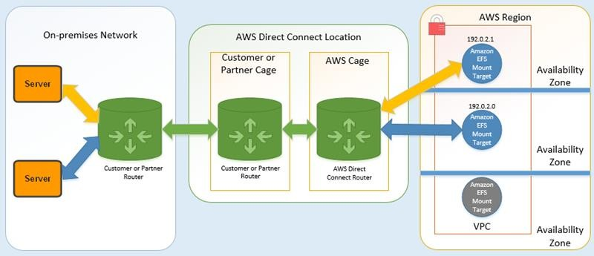
You can use any mount target in your VPC if you can reach that mount target's subnet by using an AWS Direct Connect connection between your on-premises server and VPC. To access Amazon EFS from an on-premises server, add a rule to your mount target security group to allow inbound traffic to the NFS port (2049) from your on-premises server.
To create a setup like this, you do the following:
Establish an AWS Direct Connect connection between your on-premises data center and your Amazon VPC. For more information on AWS Direct Connect, see AWS Direct Connect.
Create your Amazon EFS file system.
Mount the Amazon EFS file system on your on-premises server.

